Slide 1
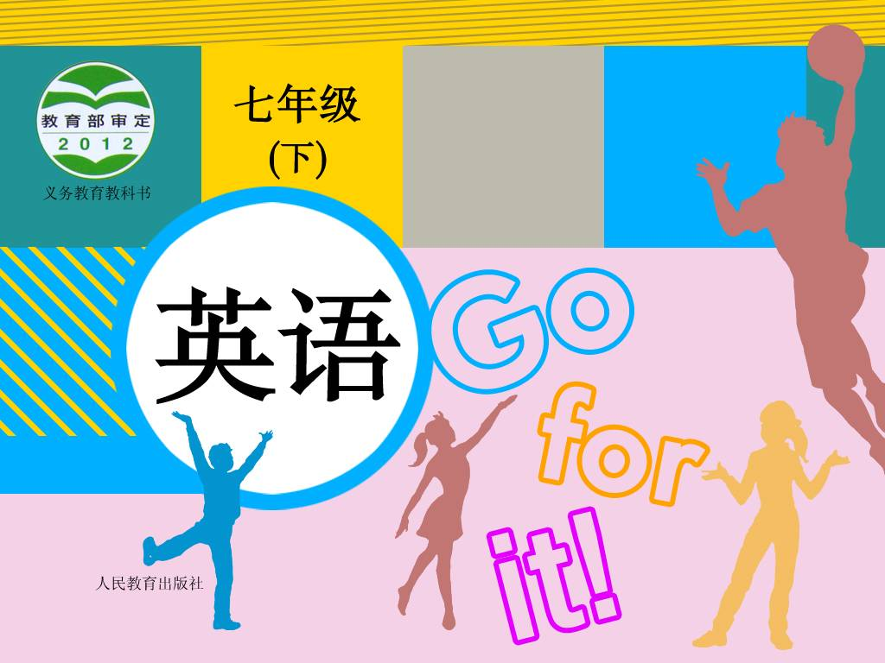
Unit 2

Slide 2

unit2 What time do you go to school
Section A 1
1a-2d

Slide 3
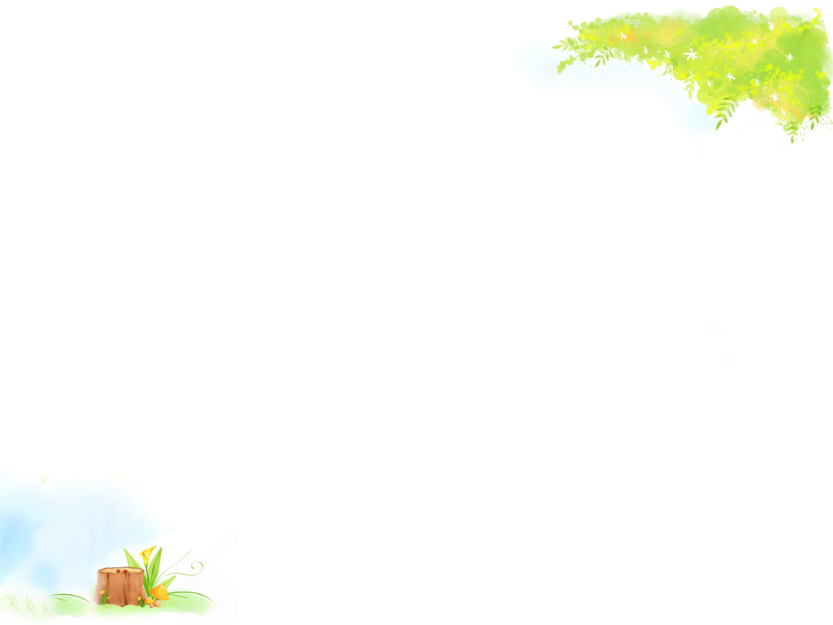
Do you know these sentences?
Time is money.
一寸光阴，一寸金。
Time is life.
时间就是生命。
Time flies.
时光如梭

Slide 4
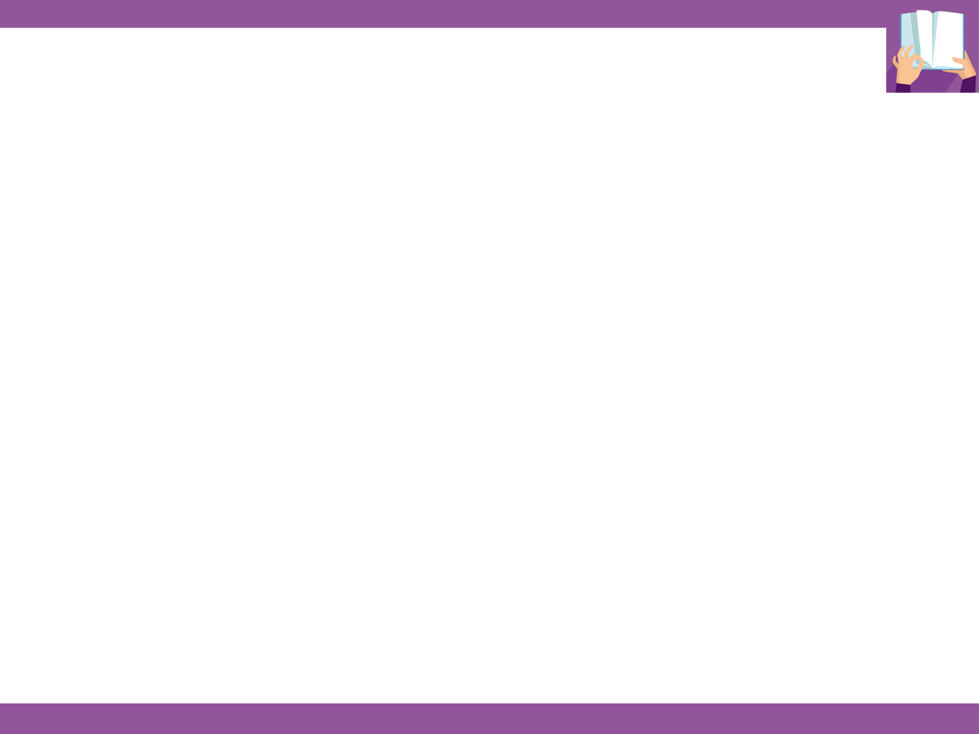
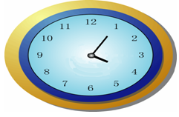
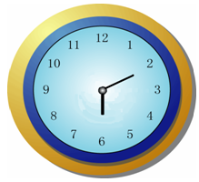
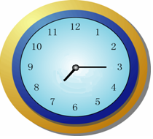
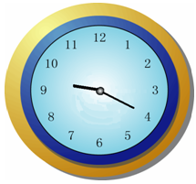
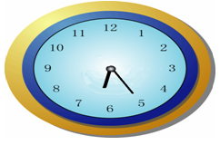
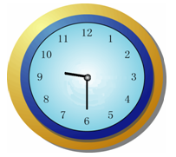
Tell the following time.
four five
six ten
seven fifteen
nine twenty
six twenty-five
nine thirty

Slide 5
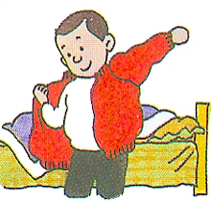
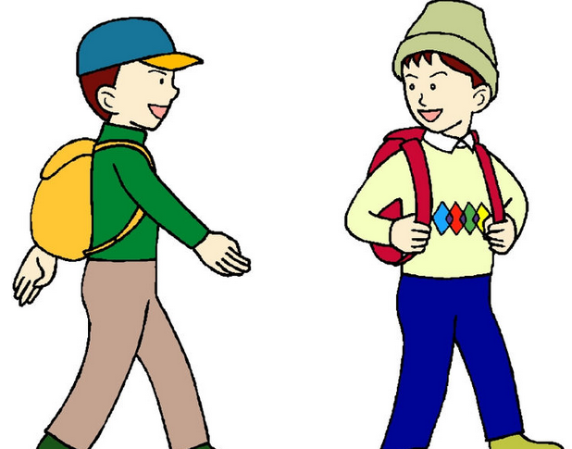
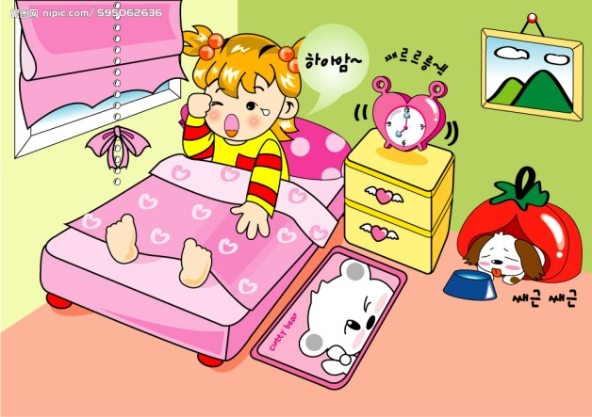
Can you speak out
what they are doing in the pictures?
get up
________
get dressed
___________
___________
go to school

Slide 6
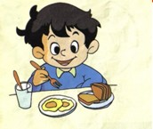
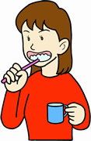
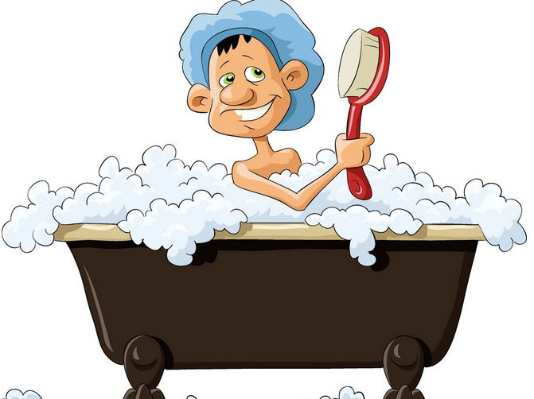
___________
eat breakfast
take a shower
brush teeth
___________
___________

Slide 7
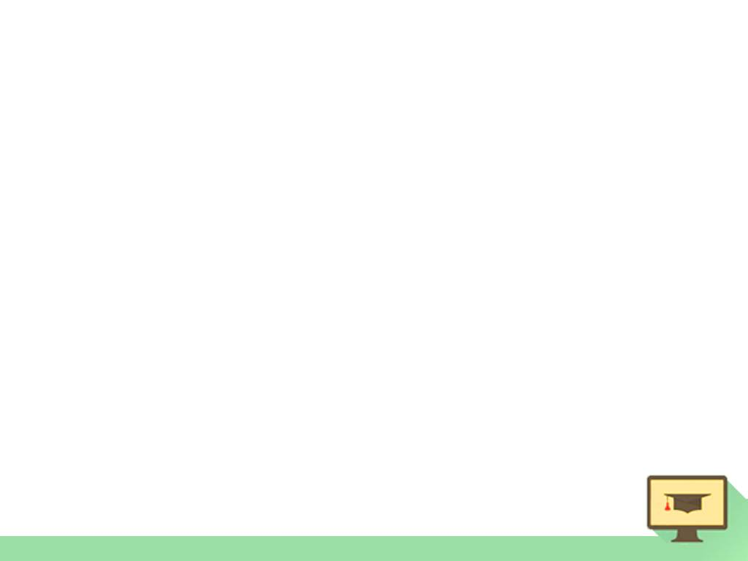
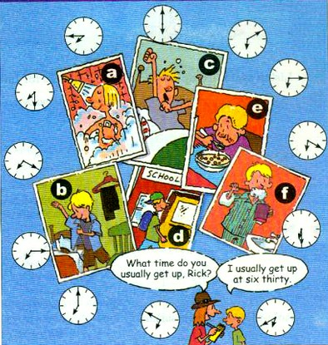
1a
Match the activities with the picture.
get up ___
go to school ___
get dressed ___
brush teeth ___
eat breakfast ___
6. take a shower ___
c
d
b
f
e
a

Slide 8

1b
Listen and match the times with the actions.
6 o’clock
6:10
6:15
6:20
6:30
6:40
6:50
7 o’clock
7:15
7:20
7:30
7:45
Get up
Go to school
Get dressed
Brush teeth
Eat breakfast
Take a shower

Slide 9
Ask questions to complete the conversation. Then role-play it.
1c
Interviewer: _______________________________,
Rick?
Rick: Um, I usually get up at six thirty.
Interviewer: And ___________________________
_______________________________
Rick: I brush my teeth and take a shower
at six forty.
What time do you usually get up
what time do you brush your teeth and take a shower?

Slide 10
Interviewer: Hmm. What time do you get
breakfast?
Rick: Seven o’clock.
Interviewer: And _______________________
___________________________
Rick: I usually get dressed at seven twenty.
Interviewer: And my last question. What
time do you go to school?
Rick: I usually go to school at seven thirty.
Interviewer: Thank you.
what time do you usually
get dressed?

Slide 11

Speaking
Work in pairs. Ask and answer questions about your partner’s day.
get up
A: What time do you usually get up?
B: I usually get up at six thirty.

Slide 12
take a shower
A: What time do you usually take a shower?
B: I usually take a shower at…

Slide 13
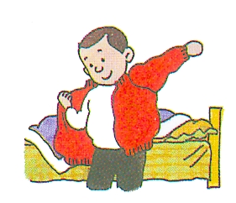
get dressed
A: What time do you usually get dressed?
B: I usually get dressed at…

Slide 14
brush teeth
A: What time do you usually brush teeth?
B: I usually brush teeth at…

Slide 15
have breakfast
A: What time do you usually have breakfast?
B: I usually have breakfast at…

Slide 16
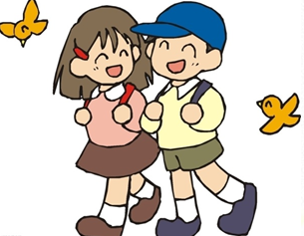
go to school
A: What time do you usually go to school?
B: I usually go to school at…

Slide 17
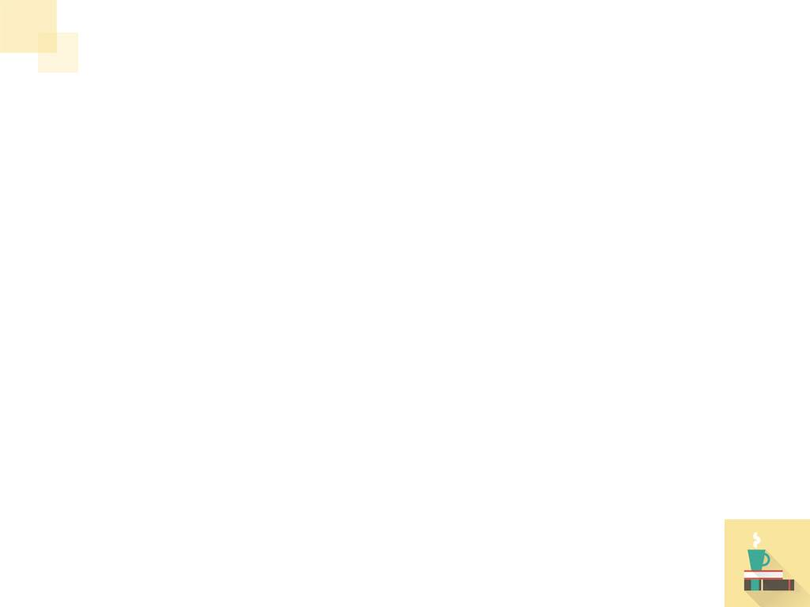
Listen to the conversation and complete the sentences.
Listening
2a
Jim has ____ brothers and ____ sisters.
Jim’s family has ________ shower.
two
two
only one

Slide 18
Listen again. Complete the shower schedule for Jim’s family.
2b
Name | Bob | Mary | Jack | Jim | Anna
Time | 5:30
5:50
6:15
6:30
6:45

Slide 19
Your time schedule
Activities | Time
get up
take a shower
get dressed
brush teeth
eat breakfast
go to school
6:00
6:10
6:20
6:30
6:40
7:00

Slide 20
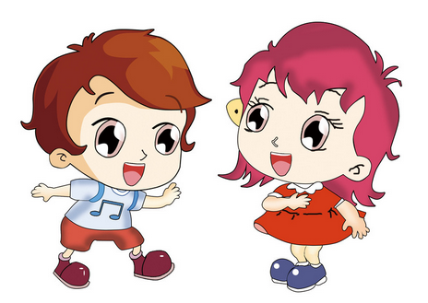
Now talk about yourself according to your time schedule.
2c
What time do you usually …?
I usually … at ….
从未
早
Wow! I never … so early.

Slide 21
Explanations
1. five fif + ty = fifty 五十
four for + ty = forty 四十
想一想: 60 _______ 70 _________
80 _______ 90 _________
sixty
seventy
eighty
ninety

Slide 22
2. always意为“总是，一直”
usually意为“通常地，一直地”
never意为“从未，绝不”
I _______ (通常) get dressed at six forty.
Jack is _______ (总是) late.
His grandpa _______ (从未) goes to school.
频率词
usually
always
never

Slide 23
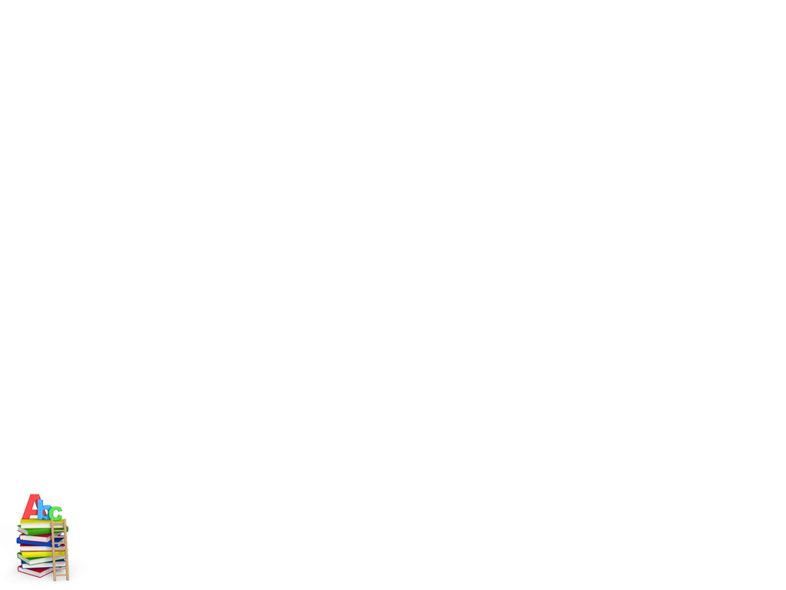
Read the conversation in 2d. Fill in the blanks about Scott.
2d
Activities | Time
get up
eat breakfast
exercise
go to work
radio show
at eight thirty at night
at nine
at about ten twenty
at eleven
from twelve o’clock at night to six o’clock in the morning

Slide 24
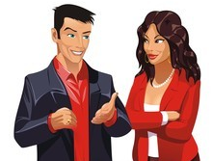
Role-play the conversation.
Scott has an interesting job. He works at a radio station. Scott, what time is your radio show?
From twelve o’clock at night to six o’clock in the morning.
…
…

Slide 25


1. Brush v. 刷；刷净 n. 刷子
e.g. He ________ his shoes before he
goes out every day.
Please pass us those _________.
brushes
brushes
2. tooth n. 牙齿
My sister’s _____ are white and pretty.
[拓展] tooth 的合成词：toothache 牙疼 toothbrush 牙刷 toothpaste 牙膏
teeth

Slide 26
3. job与work辨析
job是可数名词, 主要指有报酬的工作。
work是不可数名词, 主要指要付出努力
的劳动。
e.g. Bob wants to find a good ____.
I have much _____ to do today.
She goes to _____ at six o’clock.
job
work
work

Slide 27
4. That’s a funny time for breakfast!
time常和介词“for”搭配，表示“做……的时间”。
e.g. We don’t have too much time for sports.
我们没有太多的时间开展体育活动。
Time for dinner, children. Go and wash
your hands, please.
孩子们，饭好了。去洗手吧。

Slide 28
辨析funny与fun
funny是形容词, 意为“有趣的, 滑稽的”; fun是名词, 意为“有趣的事”；也可以是形容词，意为“有趣的，逗乐的，使人快乐的”。两者含义上的差别：funny表示“有趣的, 滑稽的”, 它指的是一种滑稽可笑的“有趣”, 侧重点是让人觉得好玩或发笑。而fun则主要指 “有趣, 好玩”, 不像funny那样强调“滑稽”。

Slide 29
翻译下列句子。
That’s the funniest joke I’ve ever heard.
_____________________________________
  We had a lot of fun at Sarah’s party.
_____________________________________
There are lots of fun things for young
people.
_____________________________________
这是我听过的最滑稽可笑的笑话。
这里有许多供年轻人玩乐的东西。
我们在萨拉的聚会上玩的很开心。

Slide 30
5. I usually exercise at about ten twenty.
exercise 的用法小结:
作动词，“锻炼”。
e.g. 他爷爷每天早晨锻炼。
His grandpa ________ in the morning.
作不可数名词，“锻炼；运动”。
e.g. 每天他都做大约十五分钟的运动。
He does about fifteen minutes’
_______ every day.
exercises
exercise

Slide 31
作可数名词，“体操；（技能）练习”。
e.g. 我们每天做早操。
We do morning ________ every day.
exercises

Slide 32
6. …so I’m never late for work.
be late for 意为“做……迟到”
e.g. 汤姆经常上学迟到。
Tom is always ____ ___ school.
late for

Slide 33

Exercises
Complete the sentences.
1. Lucy’s family has two _______ (shower).
2. An hour has ____ (six) minutes.
3. Mike _______ (brush) teeth three times a day.
4. His aunt _____ (work) at a radio station.
showers
sixty
brush
works

Slide 34
Fill in the blanks with the words in box.
at night, be late for, early, at six forty, funny, get up
gets up
1. Alice usually _______ at 6:30 in the morning.
2. His uncle works from 10:00 _______ to 6:00 in the morning.
3. His brother never goes to school so _____.
at night
early

Slide 35
at night, be late for, early, at six forty, funny, get up
4. The lazy boy __ always _______ school.
5. My sister always takes a shower __________.
6. Look at that boy. He’s really _____.
is late for
at six forty
funny

Slide 36

Interview your friends. Ask and answer questions about their day.

Slide 37


