Slide 1

Section A 1a-1c

Slide 2
Objectives
To learn to use How questions.
To learn to talk about how to get to
places.

Slide 3

Warming Up
take a bus

Slide 4
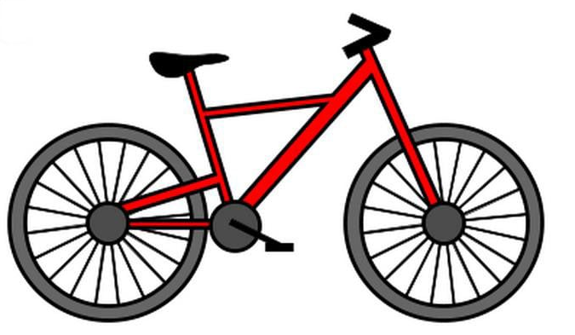
ride a bike

Slide 5
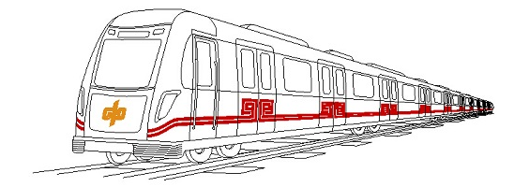
take the subway

Slide 6

take a train

Slide 7

take a car

Slide 8

take a plane

Slide 9

take the ship

Slide 10



Pair Work
How do you get to school every day?
I ride my bike.

Slide 11
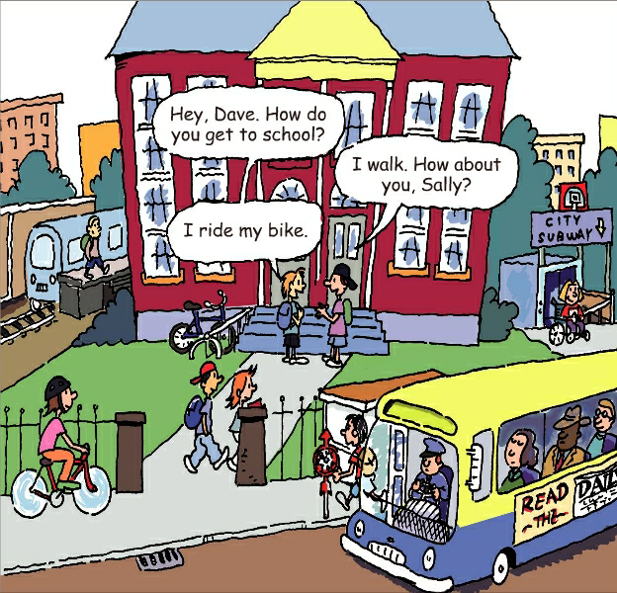
1a
Match the words with the pictures.
1. take a train ____
2. take the bus ____
3. take the subway ____
4. ride a bike ____
5. walk ____
a
d
e
a
e
b
c
b
d
c

Slide 12
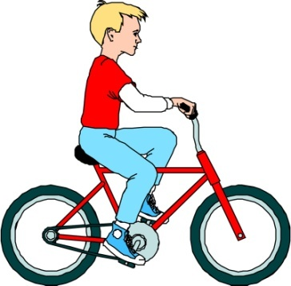

How do you get to school?
I ride my/ a bike to school.
How does he get to school?
He walks to school.

Slide 13

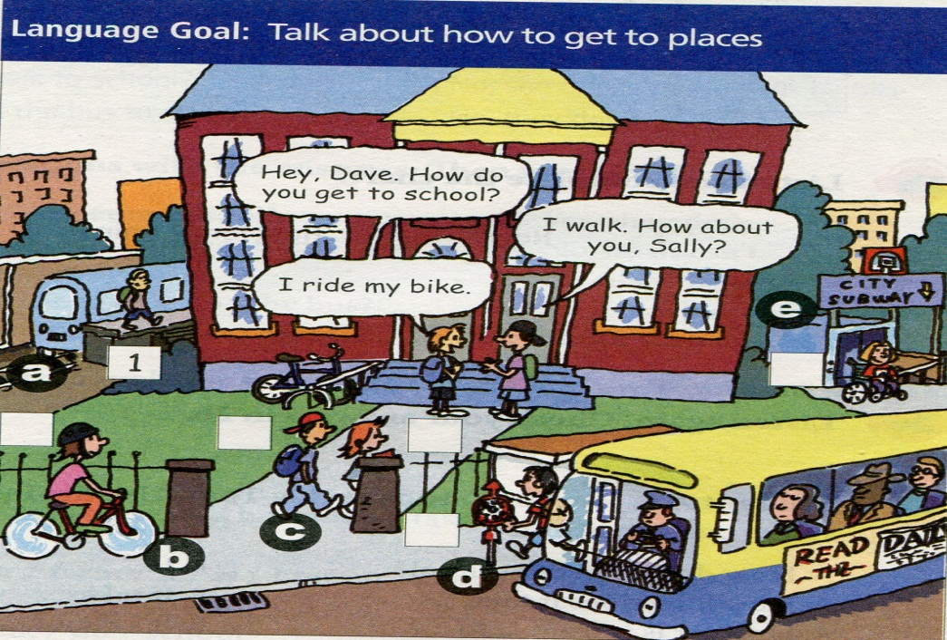
Listen and write the numbers next to the correct students in the picture above.
1b
1. Bob
2. Mary
3. John
4. Paul
5. Yang Lan
6. Jim
1
2
6
4
5
3

Slide 14
Check your answers again!
Bob takes the train.
Mary takes the subway.
Paul walks.
Yang Lan walks.
John takes the bus.
Jim rides his bike.

Slide 15
Look at the pictures in 1a. How do the students get to school? Make conversations with your partner.
1c
She takes
the subway.
How does Mary
get to school?

Slide 16

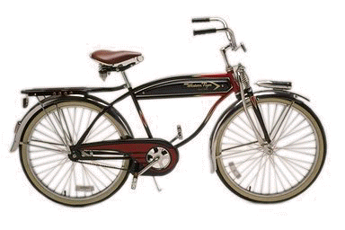
take the subway
A: How do you get to school?
B: I take the subway.
take the bus
take the train
ride a bike
walk

Slide 17
How does Mary get to school?
She _________________.
takes the subway

Slide 18


How does Bob get to school?
He ______________.
takes the train
How does John get to school?
He ______________.
takes the bus

Slide 19

How do Paul and Yang Lan get to school?
They _____.
walk

Slide 20
Language points
take the subway 乘坐地铁
take 用法
乘坐某种交通工具去某地
take + the/a + 交通工具 + to + 地点
= get/go to + 某地 + by + 交通工具
e.g.
He often takes the subway to work.
= He goes to work by subway.

Slide 21
关于subway， subway train 和subway station
在美国，subway 表示“地铁”这一地下交通系统或交通手段，常用 take the subway 或 go by subway 来表达“乘坐地铁”，但不说 take a subway 或 go by a / the subway。在英国，“地铁”称作 the underground，谈及 subways，不是表示“地铁”，而是表示“地下通道”。例如： the London Underground 伦敦地铁

Slide 22
subway train 表示“地铁列车”。
例如：
I’m on a subway train. I’ll call you later. 我在地铁上呢，我回头给你去电话。
subway station 表示“地铁车站”。
例如：
It takes him about five minutes to walk to the subway station from his home. 他从家走到地铁站约用5分钟的时间。

Slide 23
Exercises
将下列句子译成英语。
1. 你怎样去学校？我骑车去学校。
2. 她怎样去学校？她乘火车去学校。
— How do you get to school?
— I ride the bike (to school).
— How does she get to school?
— She takes the train (to school).

Slide 24
中考链接
A
I ______ to school on foot every day.
A. go B. went C. has gone

Slide 25

Make conversations about how your parents go to work. Write them down.

