Slide 1

Unit 7 It’s raining!
（ Section A 1a—2c）

Slide 2
Unit 7 It’s raining!
Unit .. 单元标题
Learning Objectives
By the end of the class, you will be able to:
1. master the words:
rain;windy;cloudy;sunny;snow;weather
2. talk about the weather with the sentence pattern:
-How’s the weather?/What’s the weather like?
-It’s sunny;

Slide 3
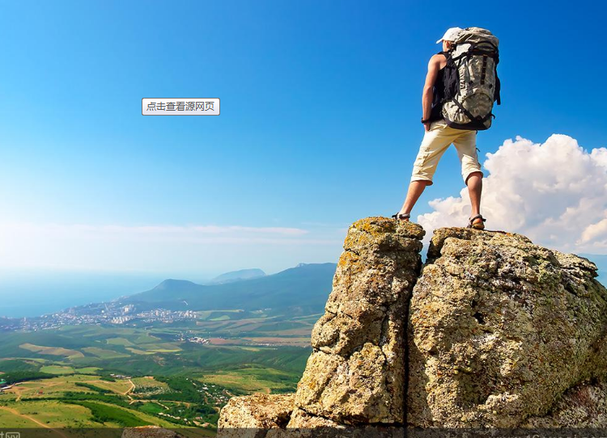
Unit 7 It’s raining!
what do you usually do on vacations?
Unit .. 单元标题
Travelling is a good choice
For me, the following places are very beautiful.

Slide 4
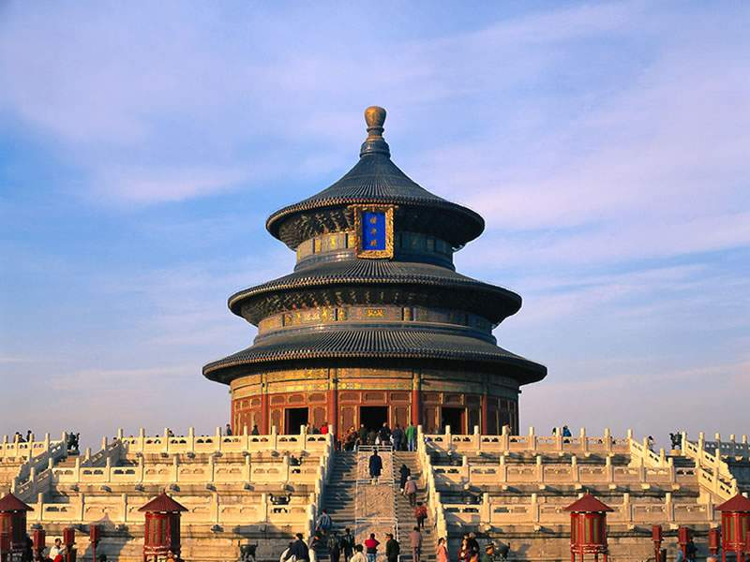
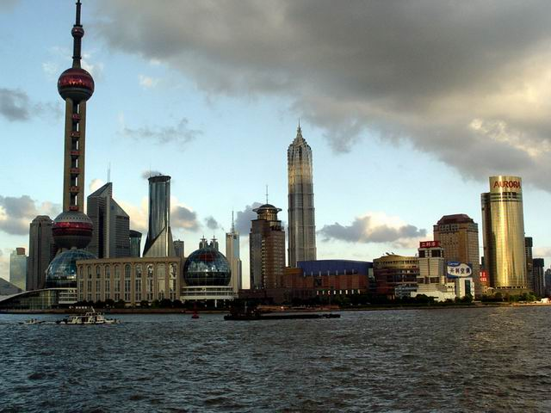
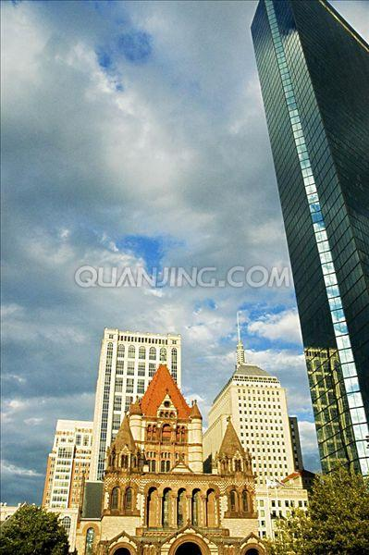
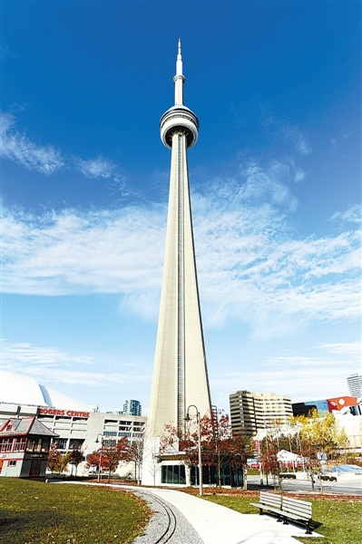
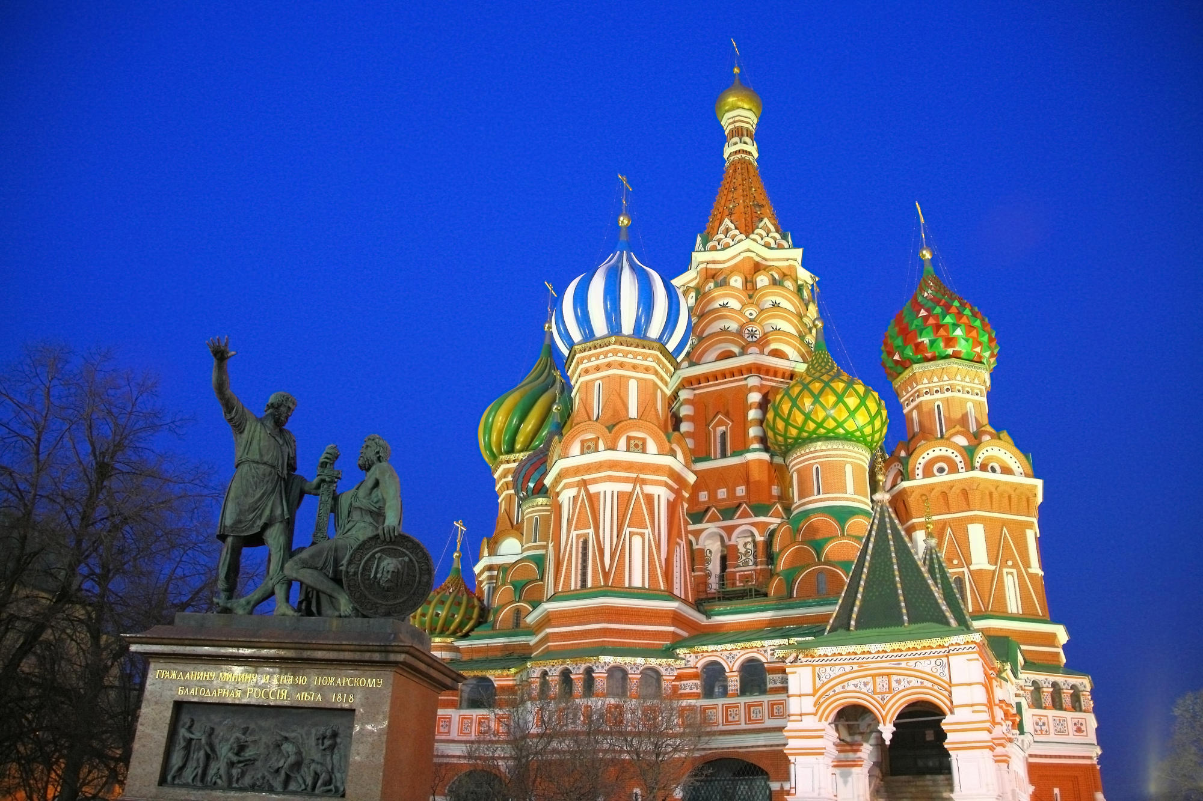
Unit 7 It’s raining!
Tiantan Beijing
the Oriental Pearl Shanghai
Church and Tower Boston
St. Basil's Cathedral
Moscow
National Tower Toronto

Slide 5
Unit 7 It’s raining!
Unit .. 单元标题
Which place do you want to go? Before going ,what is important for you?
Knowing the weather first
How can you know the weather in these places?
1.from weather forecast
2.call our local friends
Now,let’s look at the different weather.

Slide 6

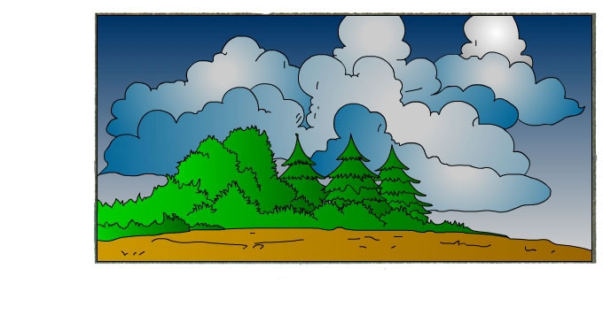
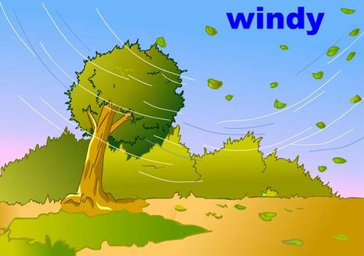
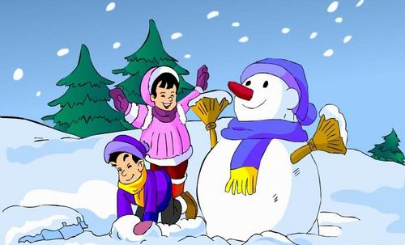
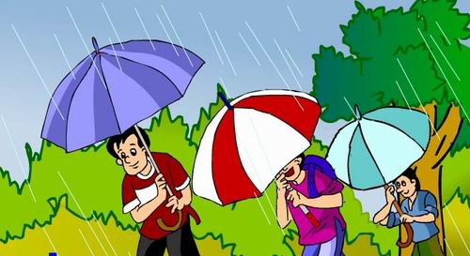
Unit 7 It’s raining!
—How’s the weather?
/What’s the weather like?
— It’s snowy/ snowing.
— It’s windy.
— It’s rainy/ raining.
— It’s
cloudy.
— It’s sunny.

Slide 7
Unit 7 It’s raining!
pair work:
A: How’s the weather in Picture1 ?
/What’s the weather like in Picture1
B: It’s windy…
1
2
3
cloudy
sunny
windy
4
5
snowing/snowy
raining/rainy

Slide 8
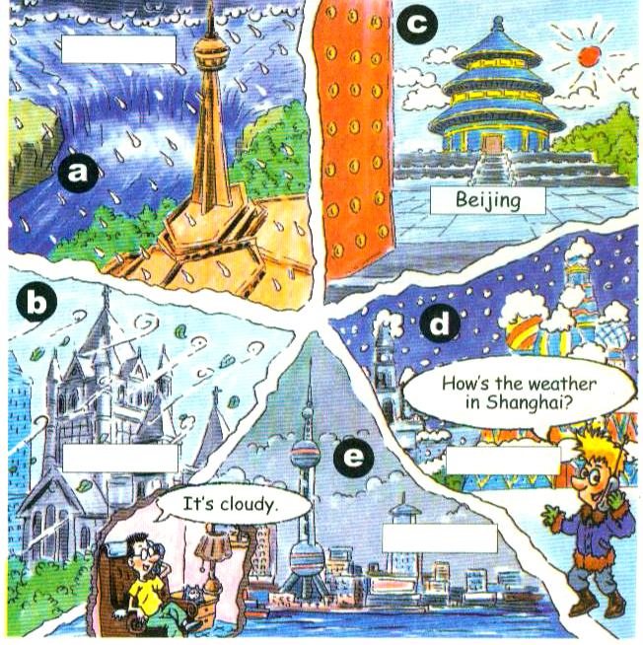
Unit 7 It’s raining!
1a
Match the words with the pictures [a-e].
raining ___
windy __
cloudy __
sunny __
snowing __
a
b
e
c
d
In picture a, it’s raining.

Slide 9

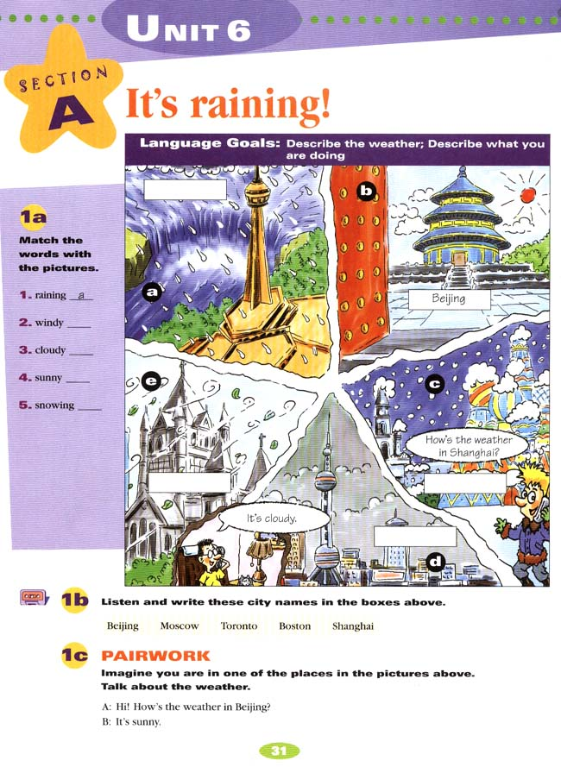
Unit 7 It’s raining!
1b
Listen and write these city names in the boxes.
Tip: Write down the first letter of the city names.
Toronto
Boston
Moscow
Shanghai

Slide 10


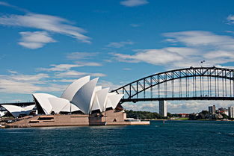
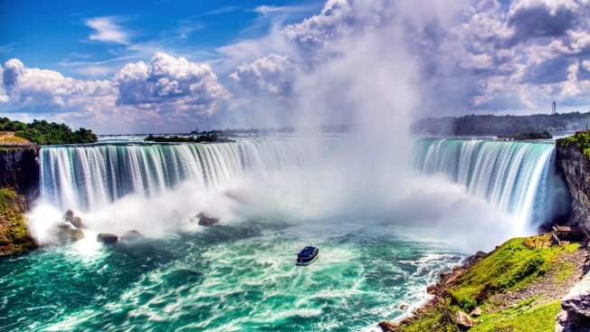

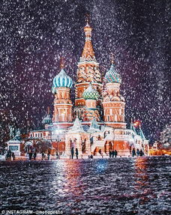


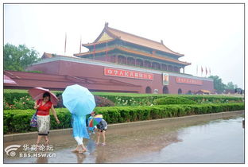
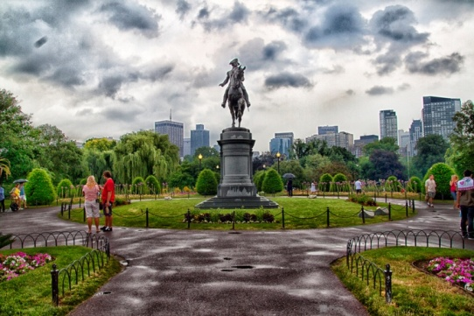
Unit 7 It’s raining!
1C
Make conversations to talk about the weather.
A:How’s the weather in Beijing?
B: It’s sunny.
Sydney
Toronto
Moscow
Beijing
Boston

Slide 11
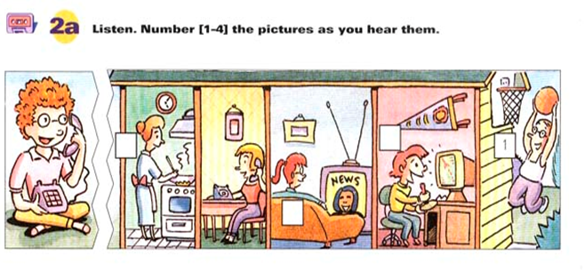
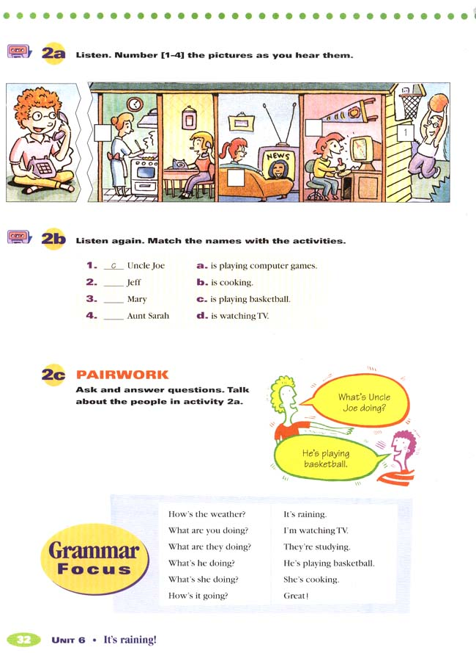
Unit 7 It’s raining!
Who is Jim talking with?
What are Linda’s families doing?
Jim
Linda

Slide 12
Unit 7 It’s raining!
2a. Listen and number the pictures.
4
2
3
In the first picture, he is playing basketball.

Slide 13
Unit 7 It’s raining!
2b. Listen again.
Match the names with the activities.
Tip:names and verbs can help you.
c
1. _____ Uncle Joe a. is playing computer games .
2. _____ Jeff b. is cooking.
3. _____ Mary c. is playing basketball.
4. _____ Aunt Sally d. is watching TV.
a
d
b
A: What’s Uncle Joe doing?
B: He is playing basketball.

Slide 14

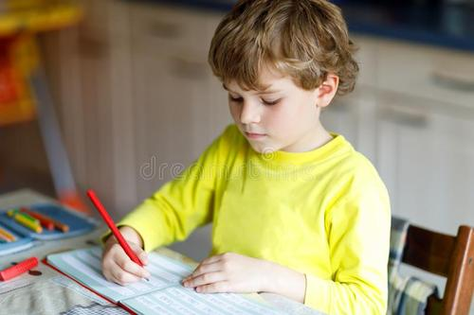

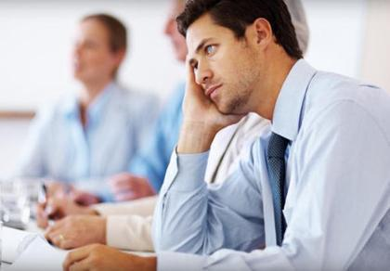
Unit 7 It’s raining!
2c. make a phone conversation with Jack in Boston like 2b.
Jack
Boston
brother
mother
father

Slide 15
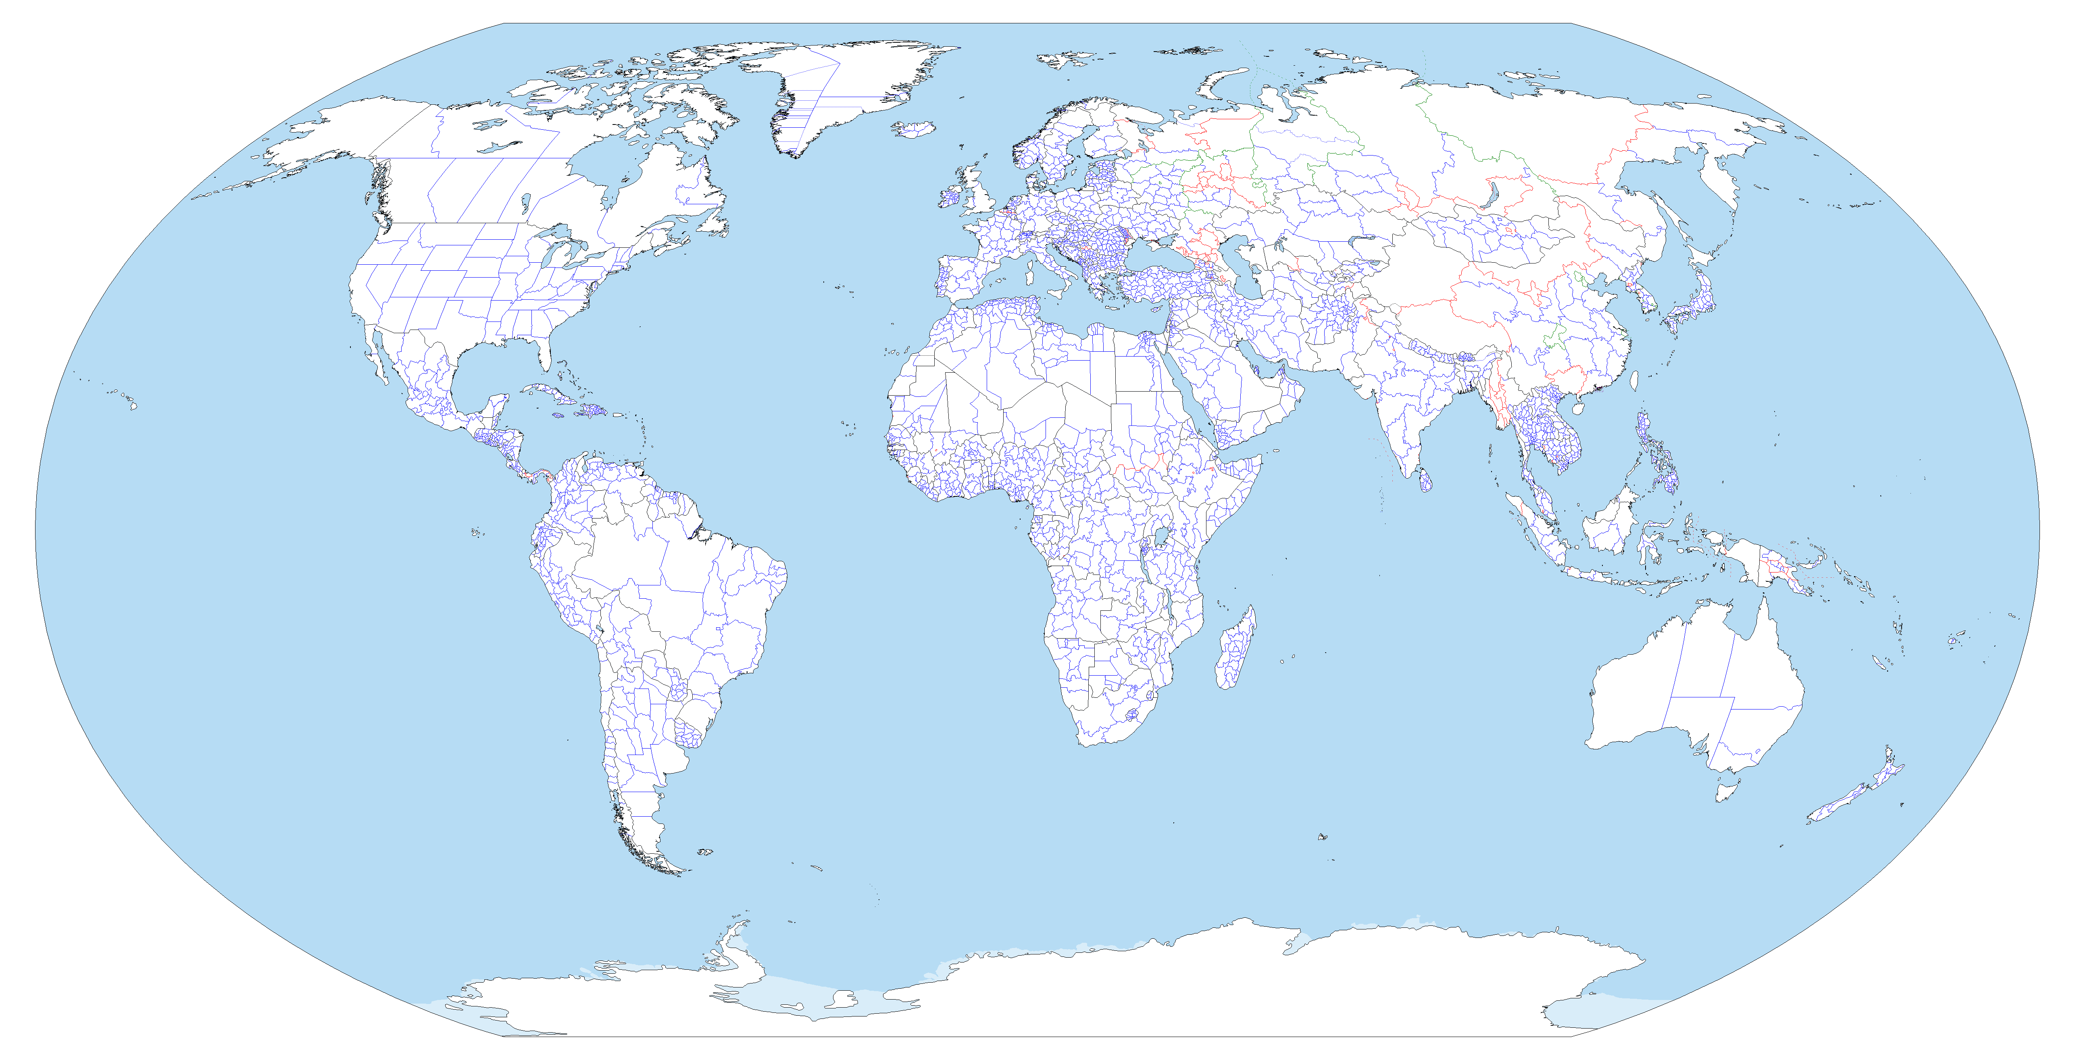
Unit 7 It’s raining!
People are doing different things
under different weather.
Because of differences, the world is beautiful!

Slide 16

write down 3 conversations to talk about the weather.

