Slide 1
Unit 7 It’s raining!
（ Section B 3a—3c）
年 级：七年级 学科：英语（人教版）
主讲人：陈 茜 学校：四川省巴中中学

Slide 2
Unit 7 It’s raining!
Unit .. 单元标题
Learning Objectives
By the end of the class, you will be able to:
Write about your vacation in a postcard .

Slide 3
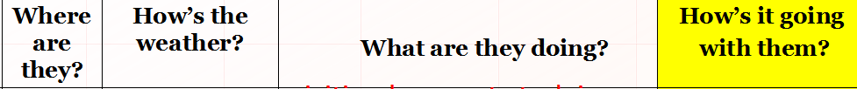
Free talk
How much do you remeber about Su Lin and Dave

Slide 4
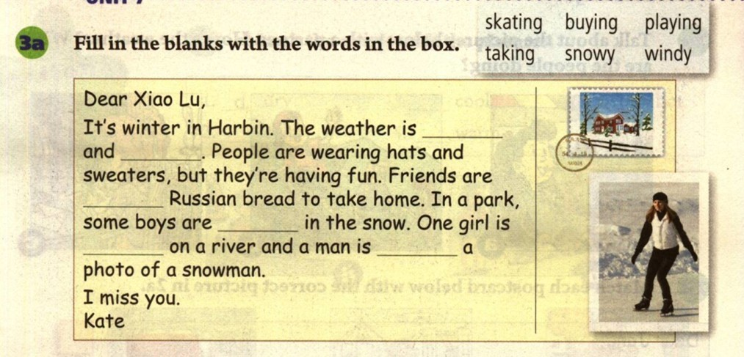
Unit 7 It’s raining!
snowy
windy
buying
playing
skating
taking

Slide 5
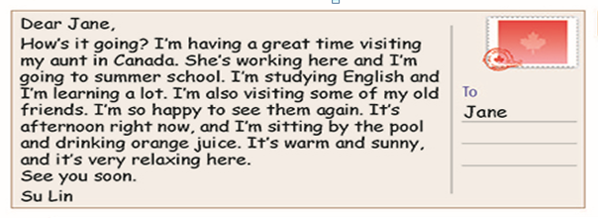
Unit 7 It’s raining!
What should we write in a postcard ?
Main part (places,weather,what you are doing , how you feel)
Greeting
Closing

Slide 6
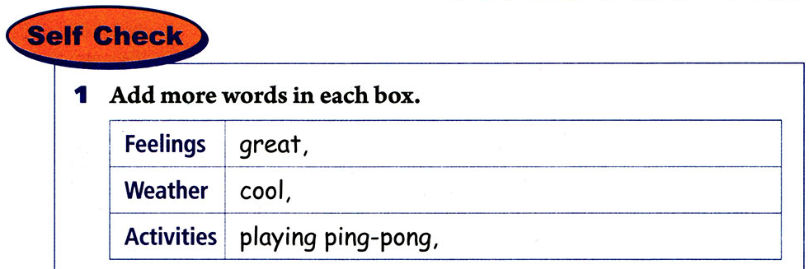
Unit 7 It’s raining!

Slide 7
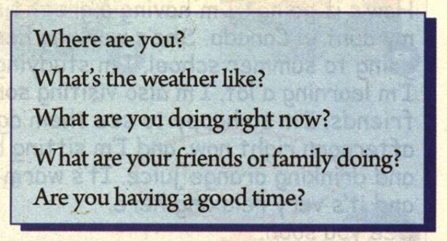
Unit 7 It’s raining!
Imagine it’s May Day. You are on vacation.
Ask and answer the questions with your partner.

Slide 8
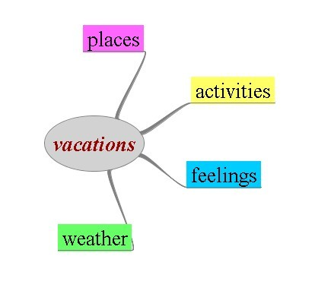
Writing time.
Imagine you are on a vacation, write a postcard to a friend.
Unit 7 It’s raining!

Slide 9
Unit 7 It’s raining!
We are on a vacation in Beijing. We’re on the
Great Wall right now. It’s cloudy and cool today.
It’s just right for walking. Look! My mother is
taking a walk. My father is taking photos of the mountains. My sister is drawing a picture. I’m
talking with some students from the US in English.
My vacation is great.

Slide 10
Unit 7 It’s raining!
Correcting time.
1. Read your deskmate’s article
and help to correct it.
2. Share your article in class.
3. Correct your own article.

Slide 11
Unit 7 It’s raining!
Homework
Correct your article and try to add more details to it.

