Slide 1

Unit 8

Slide 2
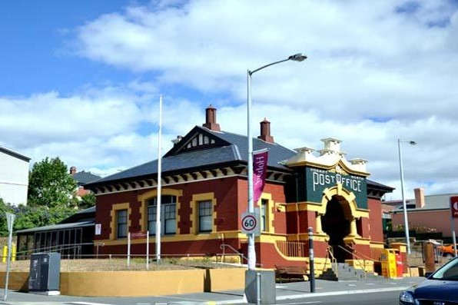
Unit 8
Is there a post office near here?

Slide 3



Slide 4


To learn to ask for and give directions on the street.
--Is there a hospital near here?
--Yes, there is. It’s on the Bridge Street.
--Where is the hospital?
--It’s behind the police station.
To learn to use prepositions of place.
on, near, between, across from, next to, in front of, behind

Slide 5



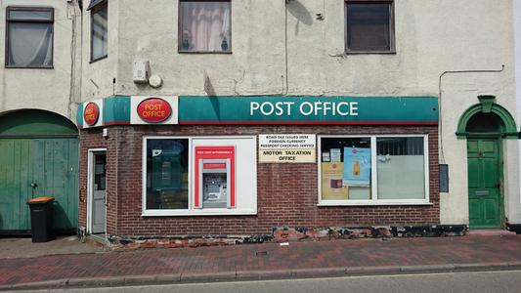

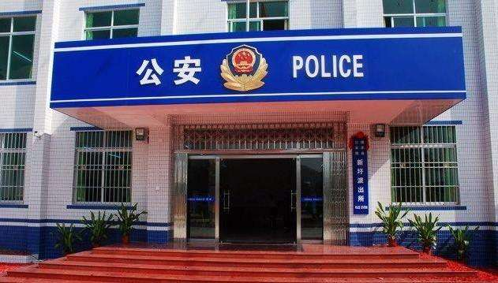
post office 邮局
restaurant n. 餐馆
police station 警察局
bank n. 银行

Slide 6
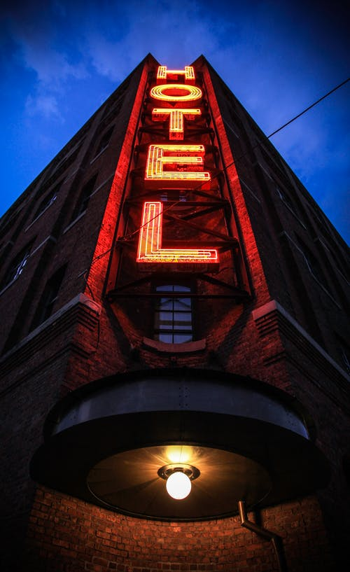
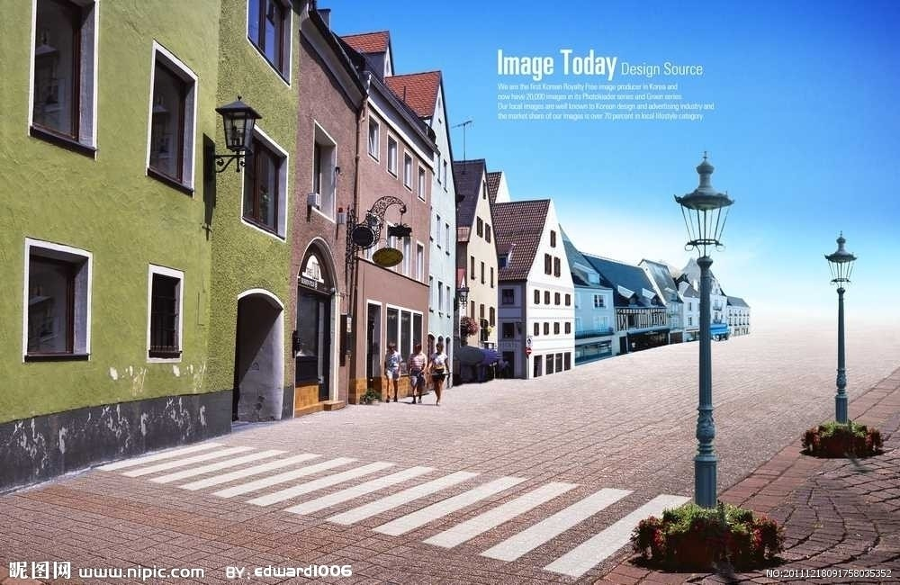
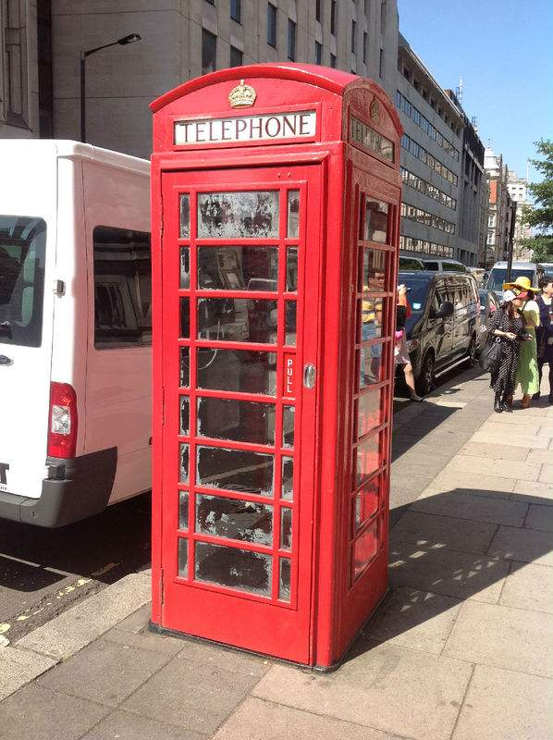
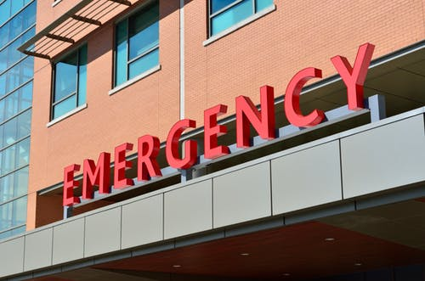
hotel n. 旅馆
street n. 大街
hospital n. 医院
pay phone 付费电话

Slide 7
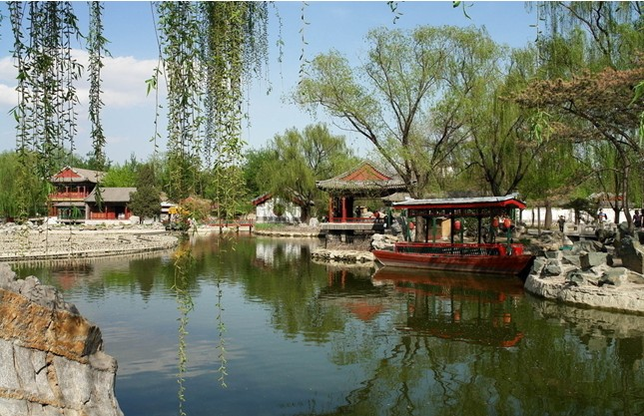
比眼力!
What’s this?
What’s that?
It’s a park.
It’s a bank.

Slide 8

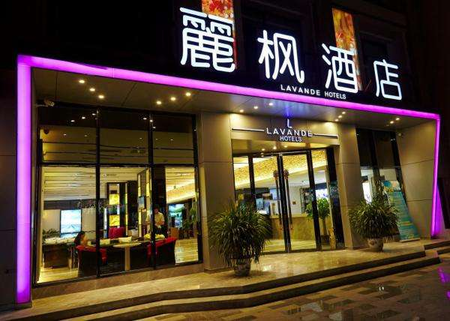
What’s this?
What’s that?
It’s a restaurant.
It’s a hotel.

Slide 9
What’s this?
What’s this?
It’s a police station.
It’s a post office.

Slide 10
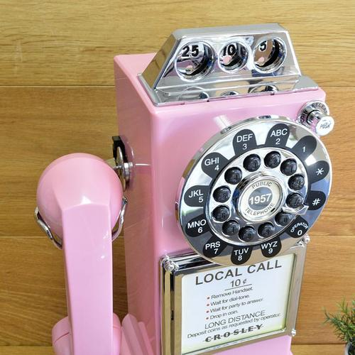

What’s this?
What’s that?
It’s a pay phone.
It’s a library.

Slide 11

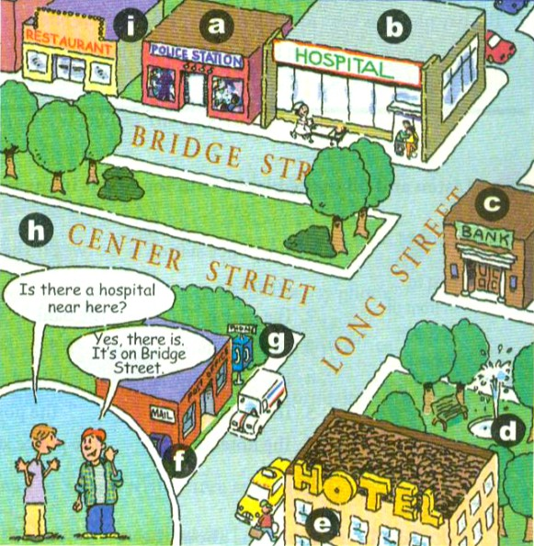
Match the words with the places in the picture.
1a
1. post office ___
2. police station ___
3. hotel ___
4. restaurant ___
5. bank ___
6. hospital ___
7. street ___
8. pay phone ___
9. park ___
f
a
e
i
c
b
h
g
d

Slide 12
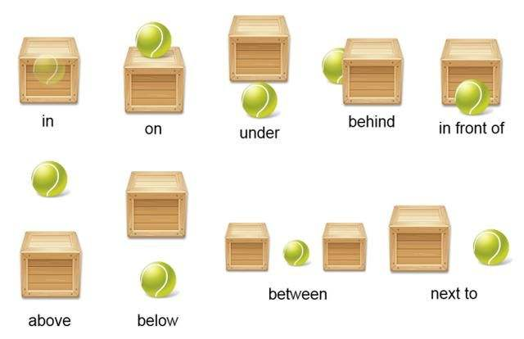
方位介词

Slide 13

Listen and circle the places you hear in 1a.
1b
post office
police station
hotel
restaurant
bank
hospital
street
pay phone
park

Slide 14
Listen again and finish the following dialogues.
Conversation 1
A: Is there a restaurant ____ Bridge
Street?
B: Yes, ______ _____.
Conversation 2
A: _____ there a post office _____ here?
B: Um, yes, there is. There’s one on
Long Street.
on
there is
在附近
Is
near

Slide 15
Conversation 3
A: Is there a _________ on Center
Street?
B: No, there isn’t.
hospital
There be +名词+地点(事物) 某处有某物
一般疑问句：
Be there +名词+地点(事物)?
某处有某物吗？
肯定回答: Yes, there is / are.
否定回答: No. there isn’t / aren’t.

Slide 16


Slide 17


Practice the conversation with your partner. Then ask and answer questions about the places in 1a.
1c
Is there a hospital near here?
Yes, there is. It’s on Bridge Street.

Slide 19

Match the sentences with the pictures. Write each number in the box.
2a
across from 在……对面
1. The pay phone is across from the library.
2. The pay phone is next to the library.
3. The pay phone is between the post office and the library.
4. The pay phone is on Green Street.
5. The pay phone is in front of the library.
6. The pay phone is behind the library.
紧邻
between …and 在……和……之间
在……的后面
in front of 在……前面

Slide 20

1. The pay phone is across from the library.
2. The pay phone is next to the library.
3. The pay phone is between the post office and the library.
4. The pay phone is on Green Street.
5. The pay phone is in front of the library.
6. The pay phone is behind the library.
4
6
2
3
5
1

Slide 21

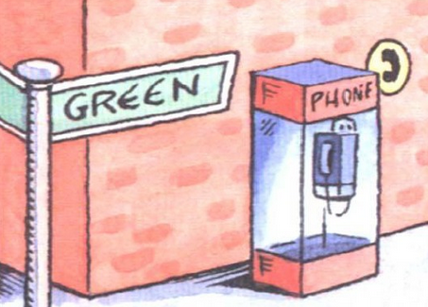
A: Where is the pay phone?
B: It’s on Green Street.

Slide 22
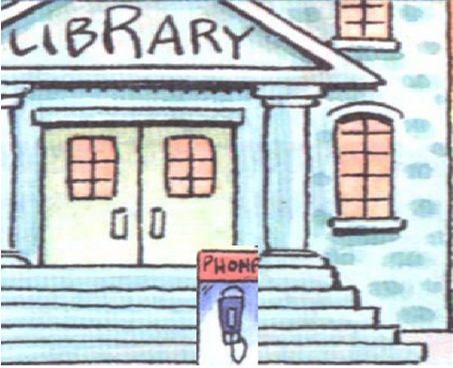
A: Where is the pay phone?
B: It’s in front of the library.

Slide 23
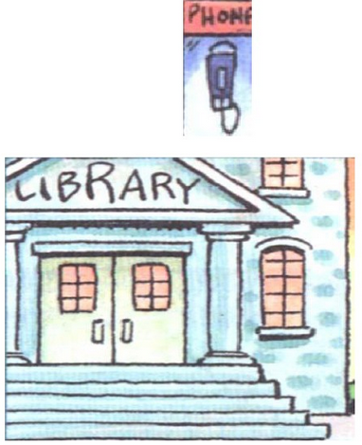
A: Where is the pay phone?
B: It’s behind the library.

Slide 24
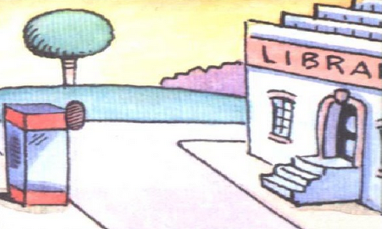
A: Where is the pay phone?
B: It’s across from the library.

Slide 25
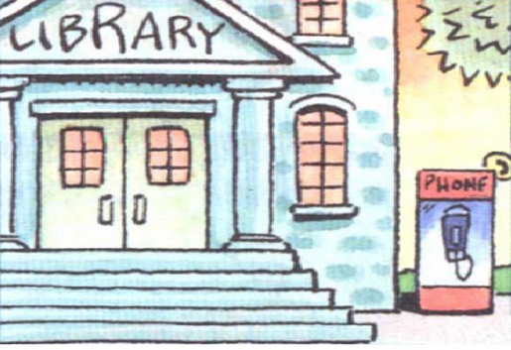
A: Where is the pay phone?
B: It’s next to the library.

Slide 26
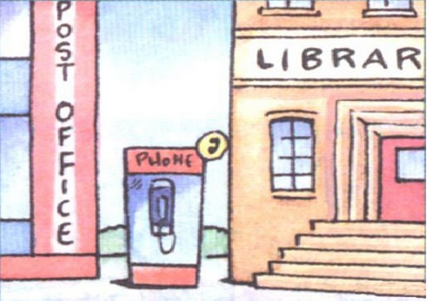
A: Where is the pay phone?
B: It’s between the post office
and the library.

Slide 27

Listen and fill in the blanks
with the words in the box.
2b
next to in front of between behind across from on
in front of 在……前面
1. The police station is between the restaurant and the hospital.
2. The park is __________ the bank.
3. The hospital is ________ Bridge Street.
4. The pay phone is ________ the post office.
5. The restaurant is _________ the post office.
6. The hotel is _________ the police station.
across from
on
next to
in front of
behind

Slide 28
Listen again and write down the questions. Then draw the places’ positions.
1. Excuse me. Is there a police station near here?
2. Where is the park?
3. Excuse me. Is there a hospital near here?
4. Where’s the pay phone?
5. Excuse me. Are there any restaurant near here?
6. Where’s the hotel?

Slide 29
Ask and answer questions about the places in 1a on page 43.
2c
A: Where’s the
hospital?
B: It’s next to the
police station.
A: Where’s the
restaurant?
B: It’s next to the
police station.

Slide 30
A: Where’s the bank?
B: It’s ….
A: Where’s the hotel?
B: It’s … the post
office.
A: Where’s the pay
phone?
B: It’s … the post
office.

Slide 31
A: Where’s the park?
B: It’s … the hotel.
A: Where’s the post
office?
B: It’s … the hotel.

Slide 32

Listen and read the conversation, then answer the questions.
2d
Is there a bank near here?
____________________________________
2. Where’s the bank? ____________________________________
3. Is Center Street far from here?
____________________________________
Yes, there is.
It’s on Center Street, across from the park.
No, it isn’t.

Slide 33
Complete the conversation.
Tony: Hi, excuse me.
Linda: Yes. ____________________
Tony: Well, I’m new in ______. Is there a
bank _______ here?
有什么可以帮您？
How can I help you?
town
around

Slide 34
Linda: Yes, _________. It’s on Center Street.
It’s ____________ the park.
Tony: Oh … where’s Center Street?
Linda: It’s not ____________ here. I can
walk with you.
Tony: Oh, that’s great! Thanks so much.
Linda: No problem.
there is
across from
too far from
离……远

Slide 35
Retell the conversation.
Tony: excuse Hi, me.
Linda: can Yes. you? I How help
Tony: here? Is there Well, new in around
town. a bank I’m
Linda: there is. Yes, It’s across from
It’s. on Center Street. the park
Tony: where’s Oh … Center Street?
Linda: It’s I can not too walk with you.
far from here.
Tony: that’s Oh, Thanks great! so much.
Linda: problem. No
Hi, excuse me.
Yes. How can I help you?
Well, I’m new in town. Is there a
bank around here?
Yes, there is. It’s on Center Street.
It’s across from the park.
Oh … where’s Center Street?
It’s not too far from here. I can
walk with you.
Oh, that’s great! Thanks so much.
No problem.

Slide 36


邮局
警察局
付费电话
在这附近
在……对面
挨着；靠近
在……和……之间
在……前面
post office
police station
pay phone
near / around here
across from
next to
between ... and ...
in front of

Slide 37
劳驾；请原谅
离……远
excuse me
far from
Sentences:
How can I help you? 我可以帮你做些什么吗？
-- Is there …?
-- Yes, there is. / No, there isn’t.
这有……吗？
是的，这有。/不，这里没有。

Slide 38


Ⅰ. 根据句意及所给首字母提示，补全句中所缺单词。
1. He usually has lunch in that Chinese r .
2. The old man has £10,000 in the b .
3. Your grandma doesn’t feel well, and we must take her to the h .
4. The rooms in this h smell terrible. I don’t want to live here.
restaurant
bank
hospital
hotel

Slide 39
near
5. My school is n my home so I can walk to school every day.

Slide 40
Ⅱ. 根据句意及所给汉语提示，写出句中所缺短语。
1. Jack, don’t play basketball ______________
(在大街上).
2. There are lots of __________(邮局) in this country.
3. Excuse me, how can I get to the ___________ (警察局)?
4. How many __________(付费电话) are there around your school?
on / in the street
post offices
police station
pay phones

Slide 41
Ⅲ. 根据对话内容和提示完成句子。
A: Excuse me! I am new to school. Can you give me some help?
B: Sure! (1)___________________(我可以帮你做些什么)
A: I want to know the way to the dining hall.
B: OK. (2)__________________________(你有地图吗)
A: Yes, here it is.
How can I help you?
Do you have a map with you?

Slide 42
B: Let’s see it. We are here right now. To get to the dining hall, you need to cross this square (广场) and go to the south. And then you can see the dining hall on your left.
A: OK. (3)_________________(它离这远吗)
B: No, it’s not far and it’s easy for you to walk there.
A: (4)___________________________________(我走路过去要多长时间)
B: Just about ten minutes.
Is it far from here?
How long will it take me to walk there?

Slide 43
A: Oh, that’s great. (5)__________________(非常感谢)
B: No problem.
Thank you so much.

Slide 44


1. Recite and copy all the words and phrases.
2. Read 2d and recite it.
3. Preview Grammar Focus and 3a—3c.

Slide 45


